Slide 1
Clinical Research in Dermatology in Scotland- challenges and opportunities
Dr Richard Weller.
NHS Research Scotland (NRS) Dermatology Lead

Slide 3
Chief Scientists Office
CSO is part of the Scottish Government Health Directorates.
Our vision is to support and increase the level of high-quality health research conducted in Scotland.
This is for the health and financial benefits of our population so that Scotland is recognised globally as a ‘come to place’ for health science.
Prof David Crossman

Slide 4
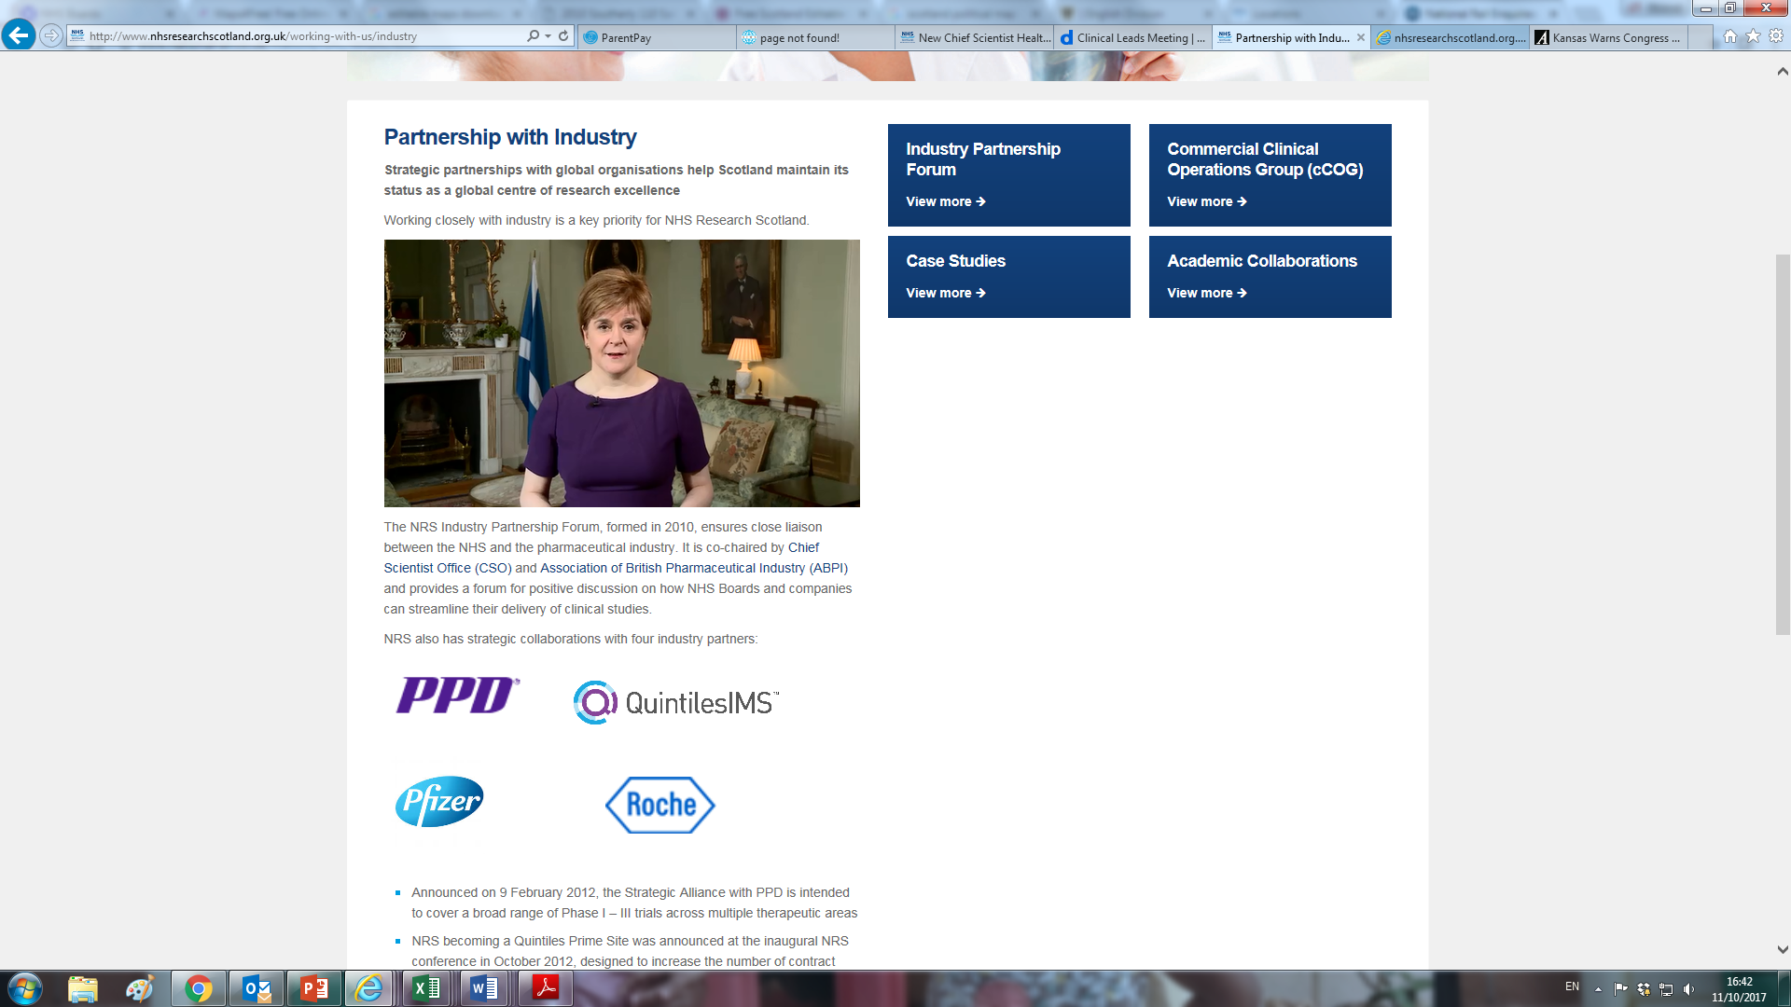

Slide 5
NHS Research Scotland
Partnership
CSO
NHS Boards in Scotland
Collaboration
Academic Institutions
Commercial companies
Aim
Agree & Implement national policy
Deliver efficiency through pan-Scotland working
No gap between policy, funding and delivery:
All round the table working to the same agenda
Notes:
Scottish Government Health and Social Care Research Strategy - http://www.gov.scot/Publications/2015/10/5164
Sets the strategic direction for NHS supported research going forward
Political commitment to supporting clinical research
Six guiding principles
Build whenever we can on the strong academic base
Seek out and deliver collaborative partnerships with a tripartite mission of research, education and delivery of quality health care, underpinned by a significant infrastructure investment
Exploit our ability to link information from health, social care and non-health sources using data to support better treatment, safety and research
De-clutter the pathway for the regulation and governance of health
Deliver collaborative arrangements with the biotechnology, pharmaceutical, informatics and medical devices industries.
Collaborate across the NHS family, academia and with other funders to position Scotland as a single research site when it makes good sense to do so
A Health and Biomedical Informatics Research Strategy for Scotland - Enhancing research capability in health informatics for patient and public benefit (2015-2020)
Complementary strategy document published in 2015 which sets out the use of high quality data as a cornerstone of the best health systems, and proposals to help drive service improvement as well as research productivity.
Other Scottish Government Policy (TBC IF REQUIRED)
A Data Vision for Scotland - supports trustworthy uses of data for public benefit
The Data Linkage Strategy – ‘Joined Up Data for Better Decisions’ sets out our ambitions for making better use of data that already exists in Scotland
The Data Linkage Framework –supports collaborative working, sharing of best practice and joined-up approaches to resource
The Scottish Informatics and Linkage Collaboration (SILC) – comprises services and facilities to support data linkage across all sectors to ensure that Scotland realises the benefits that can be derived from legal, ethical and carefully controlled use of data. The wider SILC network includes Farr and the ADRC.
The Guiding Principles for Data Linkage –
The Data Linkage Framework Programme Board (now SILC- SMB)
Public Benefit and Privacy Panel
Help deliver high quality studies in the NHS
Provide a solid infrastructure to deliver trials to time and target
Work across Scotland supporting all NHS boards
Connect NHS, industry and academia
Help involve patients and the public in research
Provide advice, support and performance monitoring

Slide 6
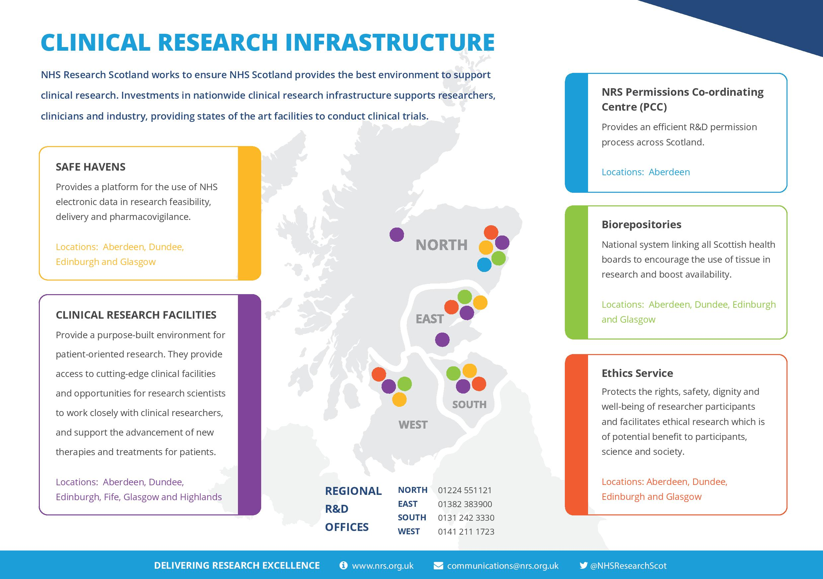

Slide 7
Current Dermatology trials in Scotland
BADBIR
B-STOP - Bio-markers of Systemic Treatment Outcomes in Psoriasis
Gene Therapy for Netherton Syndrome
HI-Light Vitiligo Trial
ALPHA study - Comparison of Alitretinoin with PUVA
Study of rare cutaneous lichenoid, alopecic and scarring variants.
Ultraviolet A1 plus narrowband UVB for atopic eczema.
Connexin-mediated signalling events in the pathogenesis of psoriasis.
APRICOT.
PLUM
The Immunology of Alopecia, and an Alopecia Biobank
Genetic Skin Disease in Scotland
A study of menthol for pain relief during photodynamic therapy.

Slide 8
CSO Investments
Direct Research Funding
Response Mode Committees / Catalytic Grants
Clinical Fellowships / Charity Collaborations / Research Units
UK-wide Research Funding Contribution
Scottish-based research access to NIHR funding streams
EME / HTA / HS&DR / PHR
NHS Research Scotland Support Budget
Activity based allocation to NHS Boards
Researcher Support / NRS Fellows / CRF-type posts/ ETC’s
Topic-specific Networks

Slide 9
Networks & Specialty Groups
Networks
Dementia & Neurodegenerative Disease
Diabetes
Mental Health
Paediatrics
Primary Care
Renal
Respiratory
Critical care
Dermatology
Gastroenterology
Genetics
Haematology
Hepatology
Infectious Diseases
Ophthalmology
Oral and Dental
Cardiovascular
Cancer
Specialty Groups
Stroke
Metabolic and Endocrine
Reproductive Health
Musculoskeletal Health
Age and Ageing
Notes:
Aim is for each study to be overseen by one Network or Specialty Group

Slide 10
What studies do we support?
High quality studies which are defined as research, involve NHS patients, data, staff or facilities, and which are eligible for the Scottish research portfolio
Notes:
Not service evaluation or audit
Research question- generisable results
Ongoing in the NHS/require NHS resources

Slide 11
Studies that are automatically eligible for the portfolio in Scotland
Studies led by Scotland with a Funder appearing on the Scottish Eligible funders list
British Skin Foundation
Psoriasis and Psoriatic Arthritis Alliance (PAPAA)
Psoriasis Association
Studies led by England with a Funder appearing on the NIHR non-commercial partner list
Studies Sponsored by a commercial organisation
Notes:
All these funders have self declared that they award funding in open competition and that the studies they fund are peer reviewed

Slide 12
Potentially eligible
Studies funded by an overseas government, overseas charity or Investigator Initiated (commercially funded but academically sponsored)
Meeting the following criteria:
Funding awarded in open competition
Peer reviewed
Clear value to the NHS
Reviewed for adoption
Notes:
If the your funder does not appear on the list we can potentially support the study if it meets the following criteria and can be put forward for adoption,

Slide 13
Benefits of Portfolio Eligibility
Support from Networks and Specialty Groups
Access to core infrastructure support- E.g CRF and Nurse resource
Treatment and support costs involved in conducting research do not need to be covered by Grant.
Board receives researcher support funding for eligible studies
Notes:
Lesley Peebles will speak more about this later

Slide 14
Costing Research
NHS bears cost of treating patients, even if that treatment is experimental
Applies to both commercial and non-commercial
Important to identify and quantify the full cost of research
Arrangements should then be in place to recover costs, so that studies are not underfunded
CSO also provide some core funding to develop the underlying infrastructure – Board allocations are activity based

Slide 15
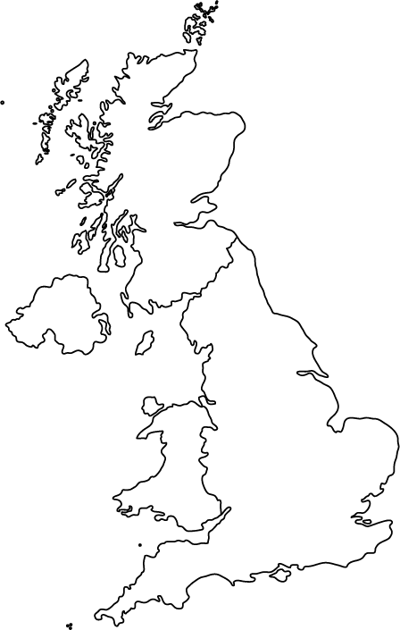
UK-wide working
Scotland
Northern Ireland
Wales
England
Notes:
Shared Ethics system
SSI unique to Scotland
Studies adopted to NRS portfolio receive support
UK Clinical Research Network Portfolio
NIHR funding to NRS to Clinical Research Centres

Slide 16
http://www.cso.scot.nhs.uk/outputs/cso-funded-research/caf/

Slide 17
NRS Career Researcher Fellowships
Protected time (2 sessions p.w. for 3 years) to engage in following activities:
Clinical research planning and protocol development
Grant writing
Carrying out clinical research
Leading or hosting multi-centre trials as chief investigator or local principal
investigator
Participation in commercial research
Dissemination of research findings, such as writing papers and presentations
at major national and international scientific meetings

Slide 18
NRS Career Researcher Fellowships
115 NRS Fellows appointed to date
Round 1 – 31 Fellows
Round 2 – 32 Fellows
Round 3 – 9 Fellows – (including one nurse consultant)
Round 4 – 17 Fellows – (including one Neuropsychologist)
Round 5 – 12 Fellows – (including 3 nurses 1 clinical psychologist)
Round 6 – 34 Applications - 14 Fellows appointed
North and East node – 4 applications – (1 NMAHP, 3 Consultants) – 2 appointed
West Node – 13 applications (2 NMAHP, 1 GP, 10 Consultants) – 6 appointed
South Node – 17 applications (8 NMAHPs, 9 Consultants) – 6 appointed
Round 1 and 2 cohort – almost all now receiving NRS researcher support

Slide 19
Questions
What are impediments to entering studies- ongoing ones and also starting new ones?
How can we all be like Kirkcaldy?

Slide 20
What and Why
Help deliver high quality studies in the NHS
Provide a solid infrastructure to deliver trials to time and target
Work across Scotland supporting all NHS boards
Connect NHS, industry and academia
Help involve patients and the public in research
Provide advice, support and performance monitoring
Notes:
Metrics. Increase total income from both commercial and non-commercial studies
R&D permission within 30 calendar days
Increase recruitment to commercial and non-commercial studies
Recruit first commercial study patients within 30 calendar days of gaining NHS permission
Increase the percentage of commercial studies recruiting to target
Ensure Research and Development is given prominence within the wider activities of the Health Board
Meeting these objectives has wider health and wealth benefits to Scotland

Slide 21
Dermatology
To support and promote excellence in clinical research in NHS Scotland, that will mAKE A POSITIVE DIFFERENCE TO PATIENTS HEALTH WITHIN SCOTLAND, THE UK AND
To place Scotland at the international forefront of clinical research.
Our Mission
Our role is to support the delivery of high-quality clinical research in Dermatology and manage participant recruitment to time and target, both for Dermatology studies which are led from Scotland, and studies led by other nations which Scottish sites are participating in
Our Vision
To place Scotland at the international forefront of clinical research.
Our Mission
To support and promote excellence in clinical research in NHS Scotland, that will make a positive difference to patients health within Scotland, the UK and internationally.
Our role is to support the delivery of high-quality clinical research in Dermatology and manage participant recruitment to time and target, both for Dermatology studies which are led from Scotland, and studies led by other nations which Scottish sites are participating in.

